Slide 1
A CONCEPTUAL SONIC APPLICATION

Slide 2
INSPIRATION
Here:Space is a data pattern analysis tool & conceptual art project that uses real time/near real ISS Telemetry data to create unique, generative aural landscapes.
Based on idea that pattern recognition is significantly different when data is interpreted aurally versus visually or textually, the translation of numerical data into sound opens up an exciting opportunity for novel engagement with a data set.

Slide 3
TECHNOLOGY
ISS TELEMETRY DATA - LONGITUDE / LATITUDE
pulled in real-time via OPEN-NOTIFY.ORG API
ANGULAR
BOOTSTRAP
HTML5
CHROMA.JS
AUDIOSYNTH.JS
INPUT
BUILT ON
TRANSLATED BY

Slide 4
AUDIO.1
Receive longitude/latitude telemetry data from ISS API
Round longitude to first decimal place and parse as integer
Match resulting integer to a corresponding preset note within the C chromatic scale
Round longitude to second decimal place and parse as integer
Match resulting integer to one of four preset octaves
Generate tone according to currently selected MIDI instrument
Repeat

Slide 5
VISUAL.1
Receive longitude/latitude telemetry data from ISS API
Round longitude to first decimal place and parse as integer
Multiply resulting integer by five to determine circle size
Match new resulting integer with one of five preset colours
Plot circle on graph using longitude/latitude as X/Y postions
Repeat

Slide 6
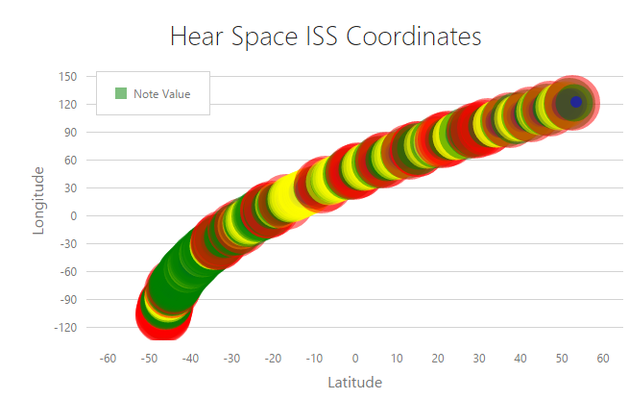

Slide 7
VISUAL.2
…
Numerical array representing the frequency spectrum of one tone is generated by audiosynth.js
Resulting array values are mapped to preset colours based on intensity level at each frequency across the spectrum
“Frequency color” is plotted as a one pixel wide image
Repeat

Slide 8
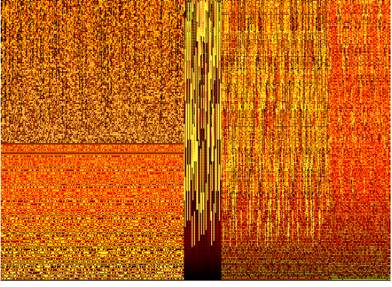

Slide 9
COLLABORATORS
DANIEL DUDLEY
NATASHA MARKOVICH
MARLING ENGLE
EUGENE MALINSKIY
JUSTIN NOLAN
STEVE MIESKOSKI
ILYA MALINSKIY

Slide 10
HTTP://ZHENYAM.COM/

